Slide 1
SHOCK

Slide 2
Shock -definition
An imbalance between oxygen demand and supply
OR
systemic reduction in tissue perfusion, resulting in decreased tissue oxygenation and insufficient removal of cellular metabolic products, resulting in tissue injury.

Slide 3
Classification of Shock
Hypovolemic- decreased preload
Distributive- decrease in systemic vascular resistance
  Septic
  Neurogenic
Cardiogenic- pump failure

Slide 4
Outcome of untreated shock
    Trauma Microbial invasion
    Burns Acute pancreatitis
    insult
    Maldistribution Hypermetabolism
    Of circulating fluid
    inflammatory response
    multiple organ dysfunction
    Death

Slide 5
Hypovolemic shock
Fluid loss resulting in inadequate circulating volume and subsequently inadequate perfusion

Slide 6
Causes
hemorrhage(internal or external)
extensive burns
refractory gastroenteritis
third space loss e.g. Pancreatitis, intestinal obstruction

Slide 7
Clinical features
Low BP(unreliable)
Tachycardia(caution-- β-blockers)
Low volume pulse
Cold clummy skin
Mental state changes
Oliguria
elevated shock index (heart rate/systolic blood pressure > 0.9)
Redistribution of blood to the brain, heart, and kidneys and away from skin, muscle, and GI tract.

Slide 8
Classes of hemorrhage
Class I hemorrhage (loss of 0-15%)
minimal tachycardia .
BP, pulse pressure, and respiratory rate are normal.
A delay in capillary refill of longer than 3 seconds
Class II hemorrhage (loss of 15-30%)
tachycardia (rate >100 beats per minute),
tachypnea,
decrease in pulse pressure,
cool clammy skin,
delayed capillary refill, and
slight anxiety.

Slide 9
Class III hemorrhage (loss of 30-40%)
marked tachypnea and tachycardia,
Reduction in systolic BP,
oliguria, and
significant changes in mental status, such as confusion or agitation.
Class IV hemorrhage (loss of >40%)
marked tachycardia,
decreased systolic BP,
narrowed pulse pressure (or immeasurable diastolic pressure),
markedly decreased (or no) urinary output,
depressed mental status (or loss of consciousness), and
cold and pale skin.

Slide 10
Markers to monitor
Urine output
Heart rate
Blood pressure
Central venous pressure
Pulmonary capillary wedge pressure
Hematocrit
Lactic acid levels
Urea electrolytes and creatinine level

Slide 11
Treatment
ABCs
IVF (colloid vs crystalloids, permissive hypotension)
Transfusion
Stop ongoing blood loss

Slide 12
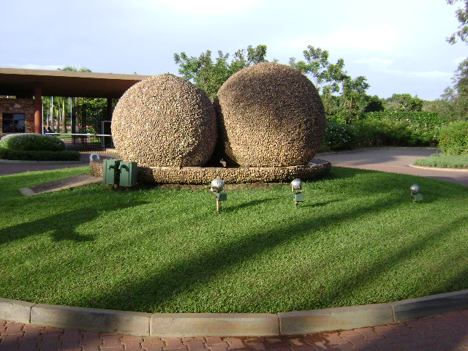

Slide 13
Septic shock
Systemic inflammatory response syndrome (SIRS) systemic response to infection.
Criteria for SIRS
Temperature > 38°C or < 36°C
Heart rate (HR) > 90/min
Respiratory rate (RR) > 20/min or PaCO₂ < 32 mm Hg
WBC > 12,000/µL or < 4000/µL, or >10% immature (band) forms

Slide 14
Sepsis: the presence of SIRS but with a demonstrable source of infection
Severe sepsis: involves organ dysfunction and hypoperfusion

Slide 15
Septic shock (definition)
Acute circulatory failure in the presence of
sepsis and
SIRS

Slide 16
Septic shock
Mechanism:
release of inflammatory mediators(cytokine storm) leading to
Disruption of the microvascular endothelium
Cutaneous arteriolar dilation and sequestration of blood in cutaneous venules and small veins

Slide 17
Inflammatory mediators
Mediator |  | Source | Effect
Platelet activating factor | PAF | Many cell types including activated leucocytes ands endothelial cells | Endogenous pyrogen Leucocyte activation ↑cap. Permeability Systemic features of SIRS
Tumor necrosis factor α | TNF-α | Macrophages/monocytes | Same effect as PAF
Interleukin-1 | IL-1 | Macrophages/monocytes | Endogenous pyrogen Leucocyte activation Systemic features of SIRS
Interleukin-6 | IL-6 | Macrophages/monocytes | Acute phase response Endogenous pyrogen Leucocyte maturation in bone marrow

Slide 18
Causes
Gram –ve or +ve septicemia from
Peritonitis
Cholangitis
Necrotic tissue
Wet gangrene
toxic shock syndrome

Slide 19
Clinical features
Early (warm shock)
Vasodilatation,
Adequate urine output,
Fever and chills
Tachypneic
Late– (cold shock)
Vasoconstriction,
Hypotension
Oliguria
Altered mental status.
Cool or clammy skin, mottling, and elevated shock index

Slide 20
Clinical features
Early
hyperglycemia,
respiratory alkalosis
hemoconcentration,
WBC typically normal or low.
Late
↑WBCs
lactic acidosis
Very Late
DIC
MOSF
NB: +ve blood cultures present in 67% of patients

Slide 21
Treatment Goals
Resuscitate the patient from septic shock using supportive measures
Identify and treat the source of infection
Maintain adequate organ system function guided by CVS monitoring and interrupt the pathogenesis of multiple organ dysfunction syndrome (MODS).

Slide 22
Principles of Treatment 1
Early recognition
Early and adequate antibiotic therapy
Source control
Early hemodynamic resuscitation and continued support
Vasopressors- nor epinephrine, dopamine or dobutamine

Slide 23
Principles of treatment 2
Corticosteroids(low hydrocortisone) in refractory vasopressor-dependent shock
Activated Protein C in sepsis-induced multiple organ failure and high mortality risk
Tight glycemic control
Proper ventilator management in patients with ARDS
Nutritional support

Slide 24
Prognosis
Mortality rate of 40-75% in several studies.
The poor prognostic factors are
advanced age,
infection with a resistant organism,
impaired host immune status,
poor prior functional status, and
continued need for vasopressors past 24 hours.
Brun-Buisson C. The epidemiology of systemic inflammatory response. Intensive Care Med. 2000;26. Supple 1:S64-74.

Slide 25
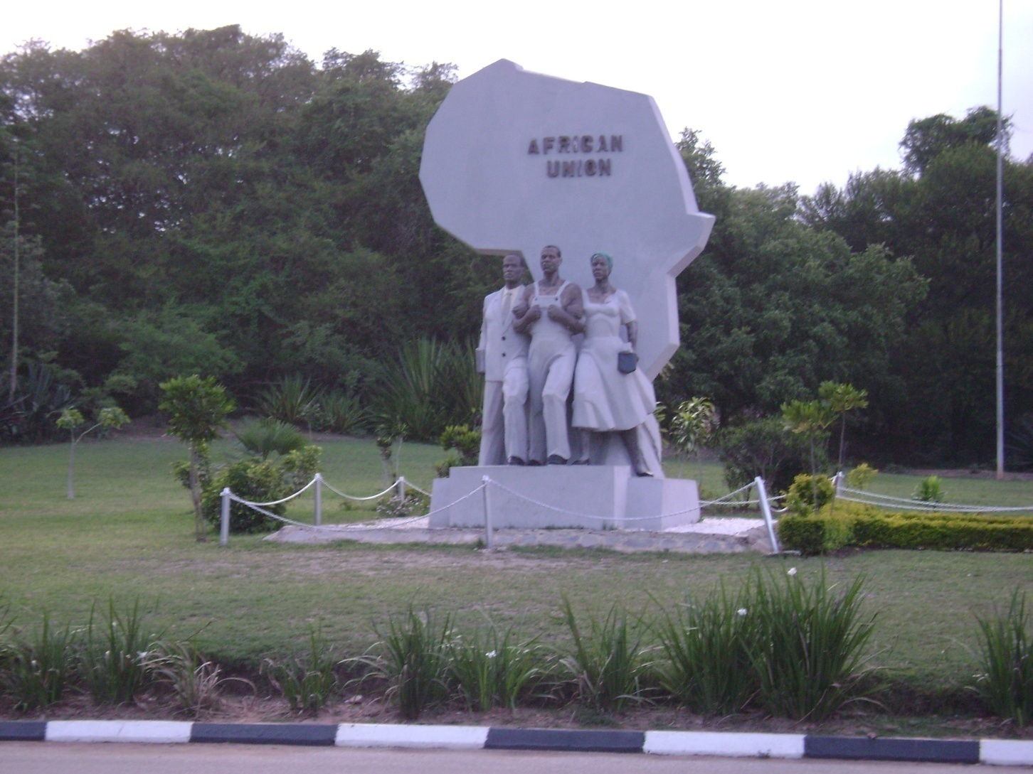

Slide 26
Cardiogenic Shock
Mechanism: inability of the heart to deliver blood into the vasculature with adequate power
Causes:
Cardiomyopathies
Mechanical: vulvular diseases
Arrhythmias
Obstructive disorders: tension pneumothorax, pericardial tamponade

Slide 27
Neurogenic Shock
Mechanism:
Loss of autonomic innervations of the CVS
Causes:
High spinal cord injury
Spinal anesthesia

Slide 28
Neurogenic Shock
Characterized by loss of vascular tone & reflexes. Results in reduced preload
Signs: Hypotension, Bradycardia, Accompanying Neurological deficits.
Treatment
    IVF
    vasoactive medications

